Slide 1
Software Product Management Funding a startup
Nandagopal Govindan

Slide 2
Contents
Funding sources
Funding stages
Angel investors
Venture Capital firms
Crowd funding
Incubators and Accelerators

Slide 3
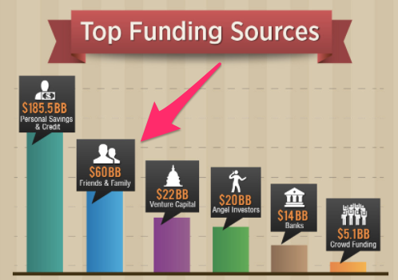
Funding sources
quicksprout.com

Slide 4
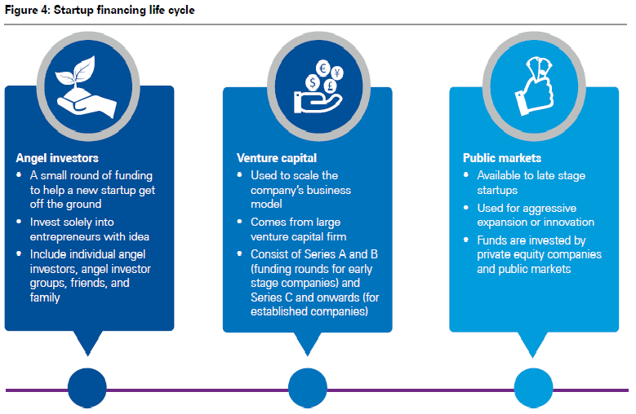
Funding stages
Source: KPMG report

Slide 5
Angel investors
Fund the company at a very early stage
Although money is their motivation, they are more likely to be genuinely interested in your business as well as the growth and development of particular industries.
They are typically entrepreneurs or former entrepreneurs themselves.
If you find the right angel investor, you may benefit from their expert advice and management skills.
Some Angel Investors
Rajan Anandan.
Anupam Mittal. ...
Anand Ladsariya. ...
Sanjay Mehta. ...
Ratan Tata. ...
Vijay Shekhar Sharma. ...
Kunal Bahl

Slide 6
Venture Capital firms
Stage 1
Wealthy people give their money to VC firms
Stage 2:
VC firms invest this money in startups after due diligence. VC firms take more risk compared to banks
VC forms get a share (15%-30%) in the company for their investment
VC firms sit on the board of Directors where they participate in making important decisions
Stage 3:
When the startup company gets acquired by another company or it goes public (IPO) they get their money back
They usually aim for 10x returns of their investment over 5-7 years
They tend to invest in a few verticals which they understand well
E-Commerce, Deeptech, FinTech, EdTech, AgriTech, Travel Tech, Logistics, HealthTech

Slide 7
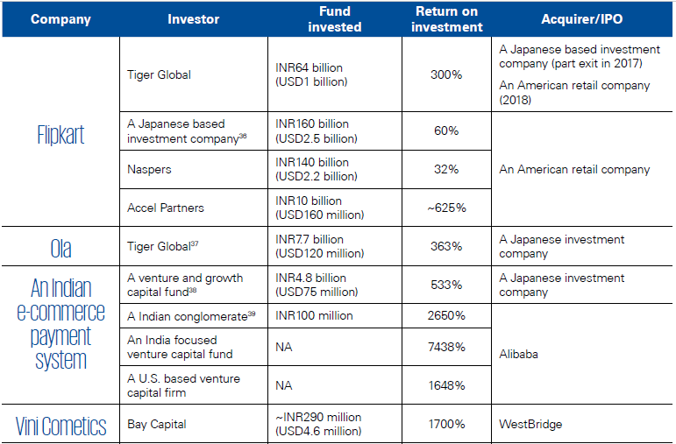
Example of returns on investment for VCs

Slide 8
Example: VC Firms
Venture Capital Firm | Domain / Vertical | Start ups Funded
Accel Partners | Infrastructure, Mobile & Software, Internet and Consumer Services | Myntra, BookMyShow, BabyOYE, Freshdesk, Flipkart etc.
SEQUOIA CAPITAL | Healthcare, Consumer Internet, Financial Sector and Technology | JustDial, Zomato, Practo, Groupon etc.
NEXUS VENTURE PARTNERS | Data Security, Mobile, Infrastructure, Bio Data Analytics, Agribusiness, Consumer and Business Services | Craftsvilla, Snapdeal, Shopclues, etc.
KALAARI CAPITAL | Internet, ECommerce, Curated Web | Snapdeal, ScoopWhoop, Myntra, Urban Ladder, Instamojo etc.
BLUME VENTURES | Mobile Applications, Internet & Software Sectors, Telecommunication Equipments, Research and Development | Cashify, HealthifyMe, TaxiForSure, Belong etc.

Slide 9
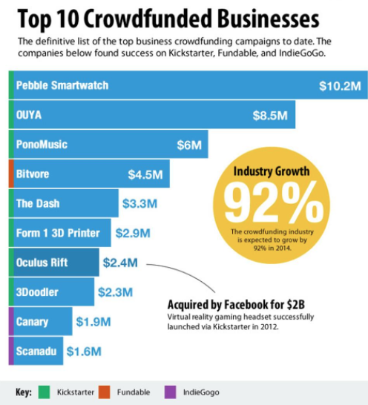
Crowd funding
Examples
Kickstarter
AngelList
CircleUp
CrowdFunder
Fundable
Source: quicksprout.com

Slide 10
Incubators & Accelerators
Incubator services
Office space
Research labs
Mentorship
Assist in raising capital
Accelerators
Build prototypes
Help in fund raising
Brand building
Customer growth

Slide 11
Example incubators and accelerators
Bangalore
Microsoft Accelerator
Khosla Labs
NSRCEL, IIM Bangalore
IIIT Bangalore Innovation
Nasscom 10,000 Startup
Mumbai
Society for Innovation & Entrepreneurship, IIT Mumbai
United India
Venture nursery
Delhi
Indian Angel Network Incubator, New Delhi
Startup Tunnel
GSF
TiE
International
Y Combinator and Techstars

Slide 12
Experience sharing
Have you had any experience with raising capital from Angel investors or Venture capital firms?

Slide 13
Appendix

